Slide 1
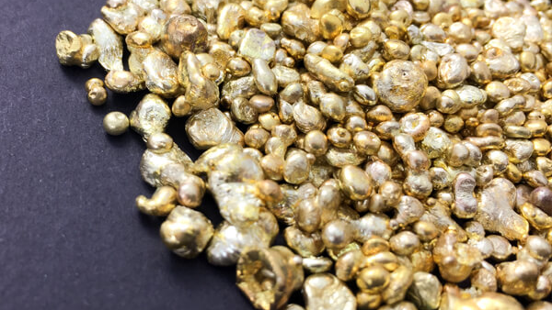
R CASE STUDY: Web Analytics
Quality Alloys, Inc.
MSBA4 TEAM 9
Roshani-Kanat-German-Ozan-Luis-June

Slide 2






AGENDA
Business Problem
Data Exploration
Business Insights
The Buyer’s Journey
Recommendation
Prediction Model
Notes:
Agenda for today’s presentation is the following: business problem, data exploration, business insights, the buyer’s journey, recommendation, and finally, prediction model.

Slide 3





AGENDA
Business Problem
Data Exploration
Business Insights
The Buyer’s Journey
Recommendation
Prediction Model

Slide 4

BUSINESS PROBLEM
The company fails to achieve the goals for the website
Drive new sales Availability of product information Brand legitimacy
Notes:
The company would like to analyze three main problems. First one is if the website has driven the sales up. The second one if information for customers is easily available. And the last, but not the least - brand legitimacy.

Slide 5

AGENDA
Business Problem
Data Exploration
Business Insights
The Buyer’s Journey
Recommendation
Prediction Model

Slide 6
Data Exploration
Step1. Understand the variables
Step2. Merge and Align the data
Step3. Find out the core variables
Step4. Plot Graphs to Visualize data
Notes:
Let me briefly explain how we did data exploration, so firstly, we understood the data, then we merged and aligned the data, third we found out the core variables, and lastly, we plotted graphs for visualization

Slide 7
AGENDA
Business Problem
Data Exploration
Business Insights
The Buyer’s Journey
Recommendation
Prediction Model

Slide 8
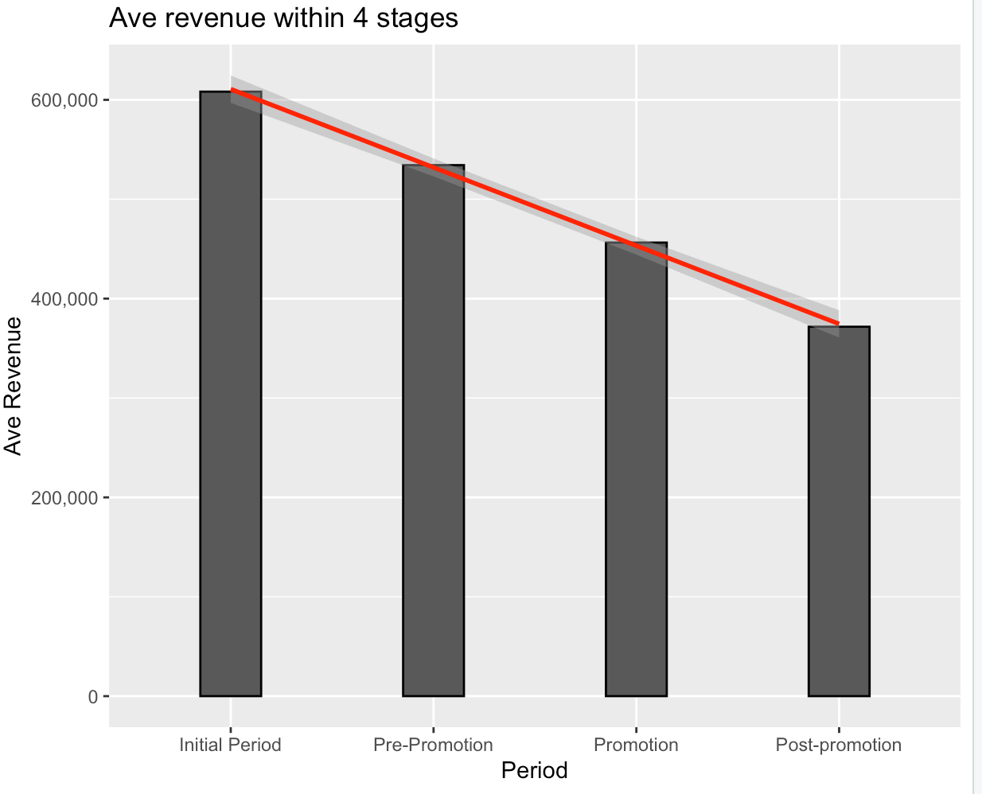

Revenue have been decreasing over time
Negative overall trend
Notes:
We have analyzed average revenue from 2008 to 2009 and noticed negative overall trend. Despite of having the website and promotion, the company has been generating less revenue

Slide 9
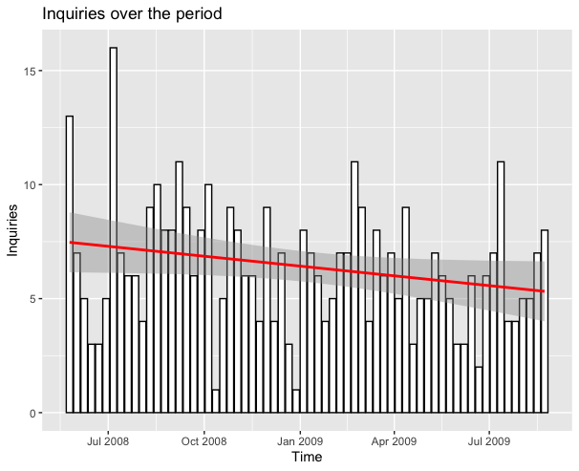
Availability of product and contact information
Persistent frequency of inquiries
Notes:
We have analyzed inquires through the website and they have been almost consistent for one year. However, one should be aware of the financial crisis of 2008, despite of which inquiries are maintained at a stable level.

Slide 10
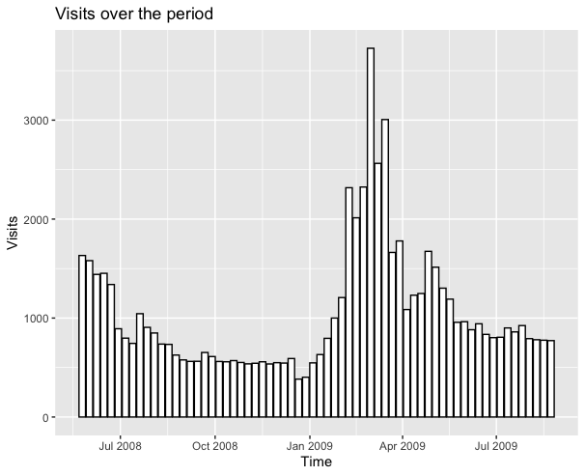
Number of visits sharply increased after January 2009
Promotion on February
Post promotion effect
Notes:
From the website visit analysis, it is clearly seen that the promotion on the month of February had impacted the rate. Before that, visits have been consistently declining. Though, 2-3 months after the promotion, visits again have decreased, however, the new stable visit rate is higher pre promotion period.

Slide 11
AGENDA
Business Problem
Data Exploration
Business Insights
The Buyer’s Journey
Recommendation
Prediction Model

Slide 12
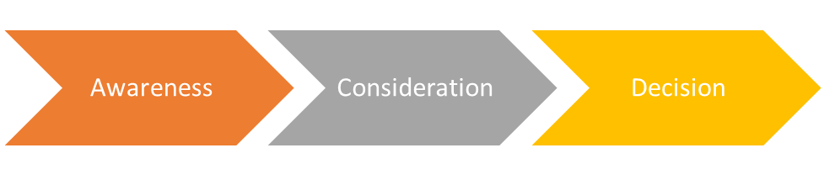
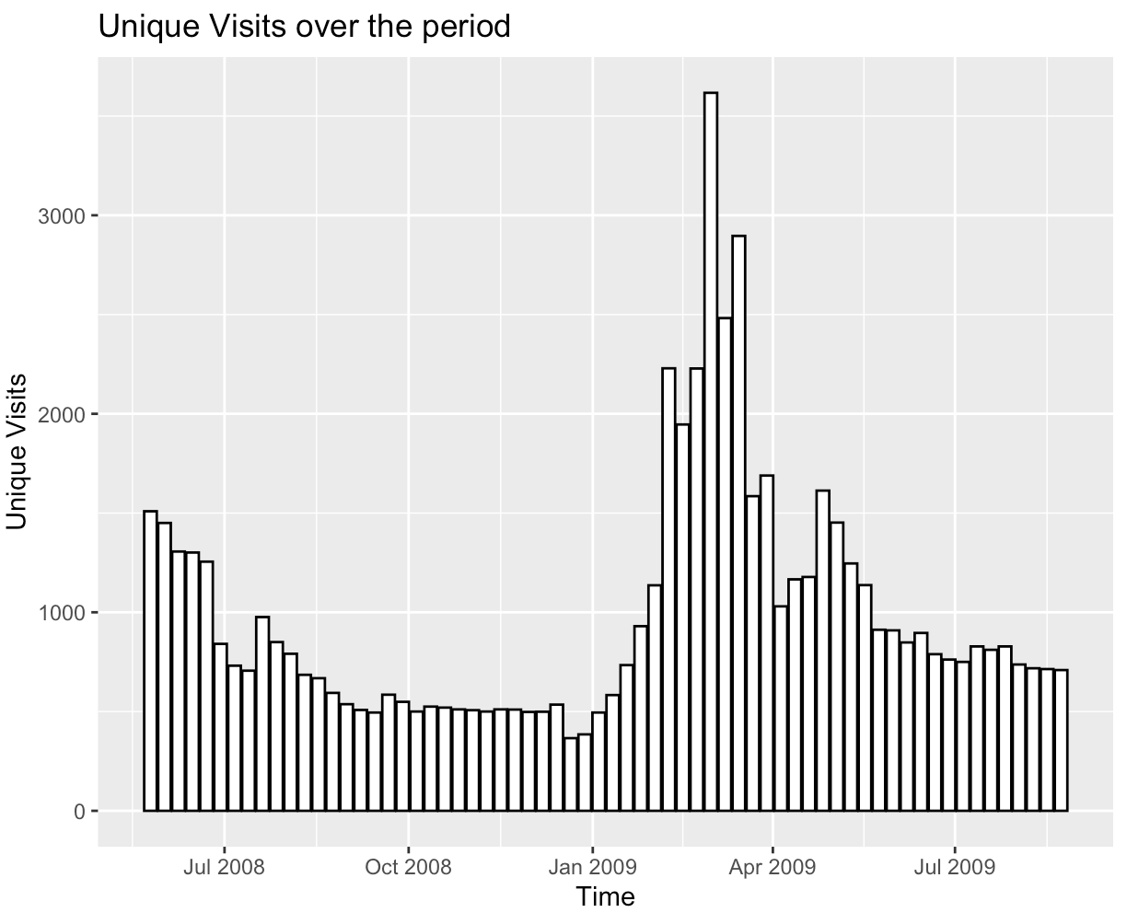
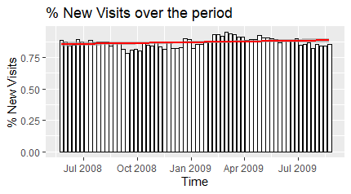
The Buyer’s Journey
Awareness
In spite of the promo’s impact, the new visits barely increased
Initial Period
Pre - Promotion
Promotion
Post - Promotion
Initial Period
Pre - Promotion
Promotion
Post - Promotion
~1%

Slide 13
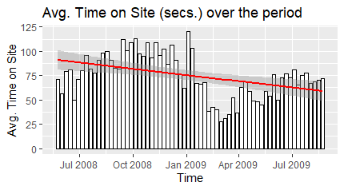
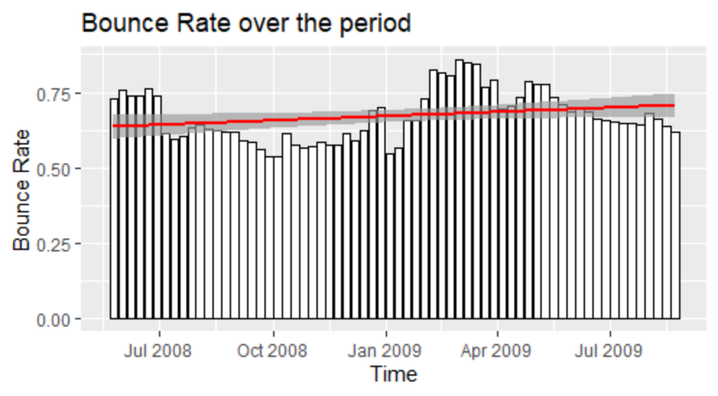
The Buyer’s Journey
Consideration
Buyers are spending less time and/or leaving faster the website
Initial Period
Pre - Promotion
Promotion
Post - Promotion
Initial Period
Pre - Promotion
Promotion
Post - Promotion
-12%
1.5%

Slide 14
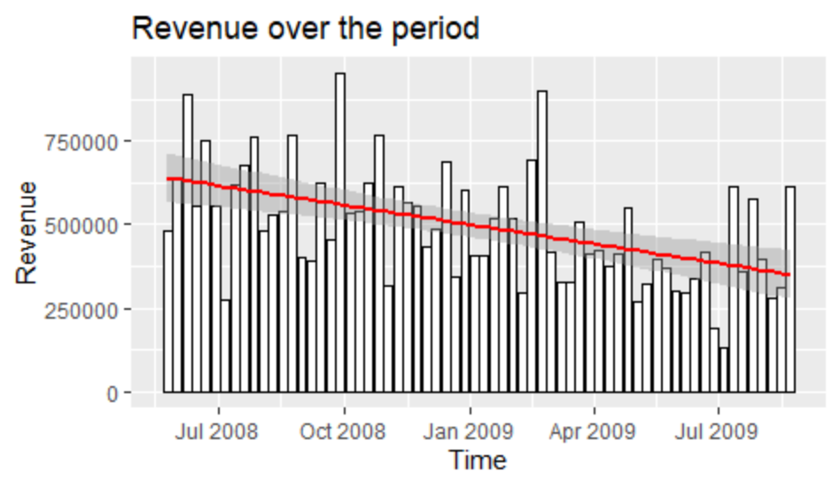
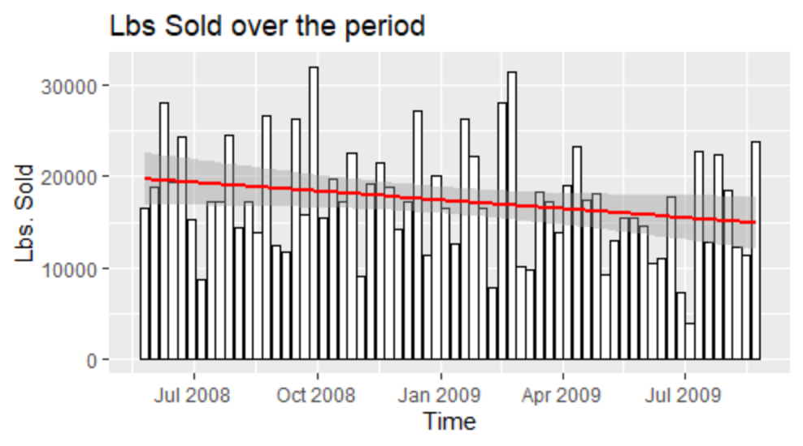
The Buyer’s Journey
Decision
The website is not influencing the buying decision power over time
Initial Period
Pre - Promotion
Promotion
Post - Promotion
Initial Period
Pre - Promotion
Promotion
Post - Promotion
-39%
-22%

Slide 15

AGENDA
Business Problem
Data exploration
Business Insights
The Buyer’s Journey
Recommendation
Prediction model

Slide 16
Recommendation
Notes:
Our buyer’s journey analysis demonstrates that the company failed at providing a better online purchase experience. In other words, something went wrong during consideration stage and making decision stage. Therefore, we will come up some recommendations to tackle the problems that can accelerate consumer’s buying intention and decision-making.

Slide 17
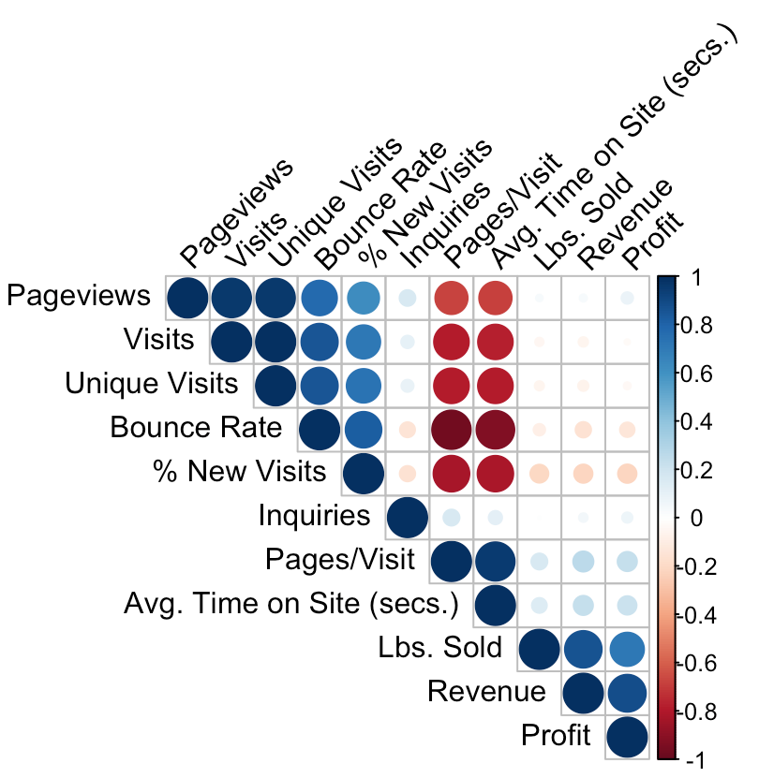
The Correlation with revenue
Higher bouncing rate might brings Lower revenue
More new visitors don’t increase more revenue
Higher pages per visit and higher average time onsite have higher potential of increasing revenue
Size- high/low correlation
Color- positive / negative relationship
Notes:
Before we came up our recommendation, we need to understand which variable is correlated to revenue. According the the correlation matrix, we figured out that besides financial indicators, none of the variable has high correlation with revenue, lower than 0.25. But we can see the top 4 high-correlated variables- Bounce rate, % New visits, Page/Visits, Avg Time on Site. These 4 variables tell us 4 stories about market reaction toward our websites. High bounce-rate might brings lower revenue, because the websites does not motivate buyer’s purchase intention . More visitors don’t increase more revenue. Mostly, new visitors are people who are aware of our brand but low intention of buying our products. High Pages per visits and average time on site will bring higher revenue because it strongly indicates that customers are thinking about buying our products.

Slide 18


Recommendations
We will focus on ….
Bounce rate -
Page per visit +
View Pages +
Notes:
Therefore, we will focus on increasing the engagement with customers that can lead them to buy our products. We decide to address the issue of high bounce rate and we would like to increase number of the views on pages and page per visits.

Slide 19



Recommendations
Optimize website’s content
Customized Email Marketing
Optimize the inquiry form
Notes:
So, our recommendations are optimizing website’s content, implementing customized email marketing and optimizing the inquiry form.

Slide 20
Optimize Website Page
-Product educational information
-Optimize website speed
-Testimonial on the webpage
Reviews on a website increase conversions by an average of 20%.
77.3% of consumers said that reviews impacted their purchasing decision.
Notes:
https://www.bigcommerce.com/blog/bounce-rates/#this-bounce-rate-equation-doesnt-tell-the-whole-story
First is to optimize website page. To reduce the bounce rate on website, one key takeaway is to make sure website has high quality of user interface of the website.
If your website user interface is bad and your website does not provide visitors information effectively, your visitor will leave the website right away. Therefore, you need to provide educational information and optimized website speed. We also recommend to put testimonial on the webpage, because 77.3% of consumers said that reviews have impacts for their decision making process. Therefore this can drive sales conversion.

Slide 21
Customized Email Marketing
-Invitation for product consulting
-Personalize monthly newsletter
Personalized promotional emails had 29% higher unique open rates
and 41% more unique click-through rates
Notes:
Personalized promotional emails had 29% higher unique open rates and 41% more unique click-through rates in 2013
https://www.campaignmonitor.com/blog/email-marketing/2018/12/70-email-marketing-stats-you-need-to-know/
Next one is implementing customized email marketing.
Personalized promotional emails had 29% higher unique open rates and 41% more unique click-through rates. Plus, email is one of the top 10 referring sites, so we are going to leverage it. We highlight these two types of email to start a conversation with customers, invitation of products consulting, personalized monthly newsletter. Different industries has different demand for alloy. Invitation of product consulting allows company to know about customers need in each industry meanwhile the company can give advice for customers, telling them how other people do in the industry.
Personalize monthly newsletter can provide different types of products information for different customer segmentation. We believe that the email marketing strategy can gain trust from the customers, making the company stands out between the competitors.

Slide 22
Recommendations
Optimize the inquires form
Notes:
Our last recommendation is optimization of the inquiry form.

Slide 23
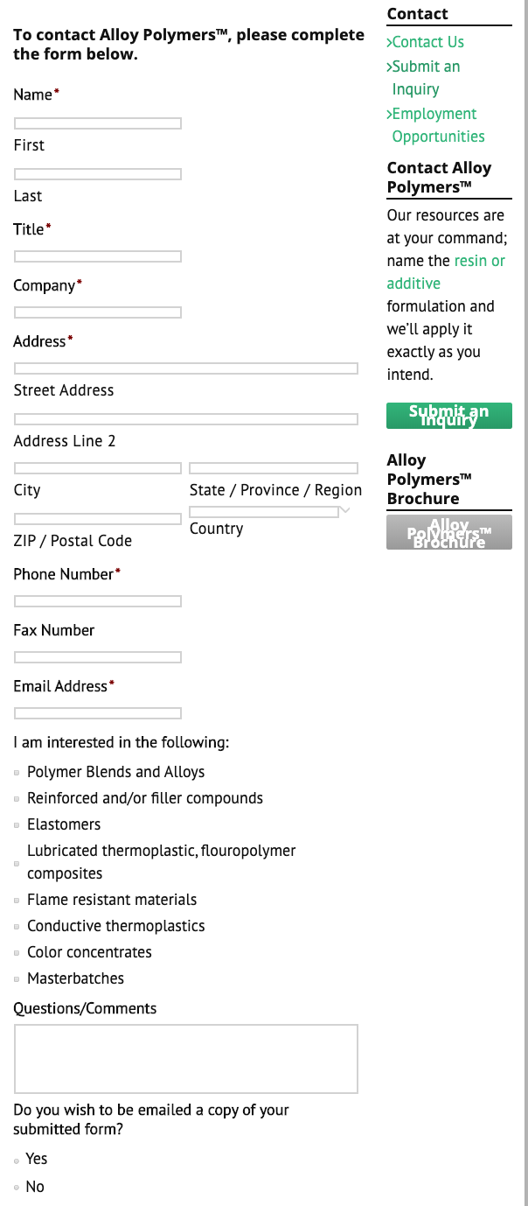
Most of the inquiries look like…
Notes:
We found that most of the competitors only have basic inquiry form.

Slide 24
Understand CM needs from inquiries
Besides the basic contact information…
-Business products
-Customized information
(Sized, type of materials, description of usage )
-Available contact hour
Notes:
We suggest we can add more items on inquiry form, so the company can understand customers needs before contacting with them, such as business products, customized information and available contact hour. We recommend they can add available contact hour that can understand when is the best convenience to reach out our global customers, like Asia and Europe, which the area attributed for 28% of total visits.

Slide 25
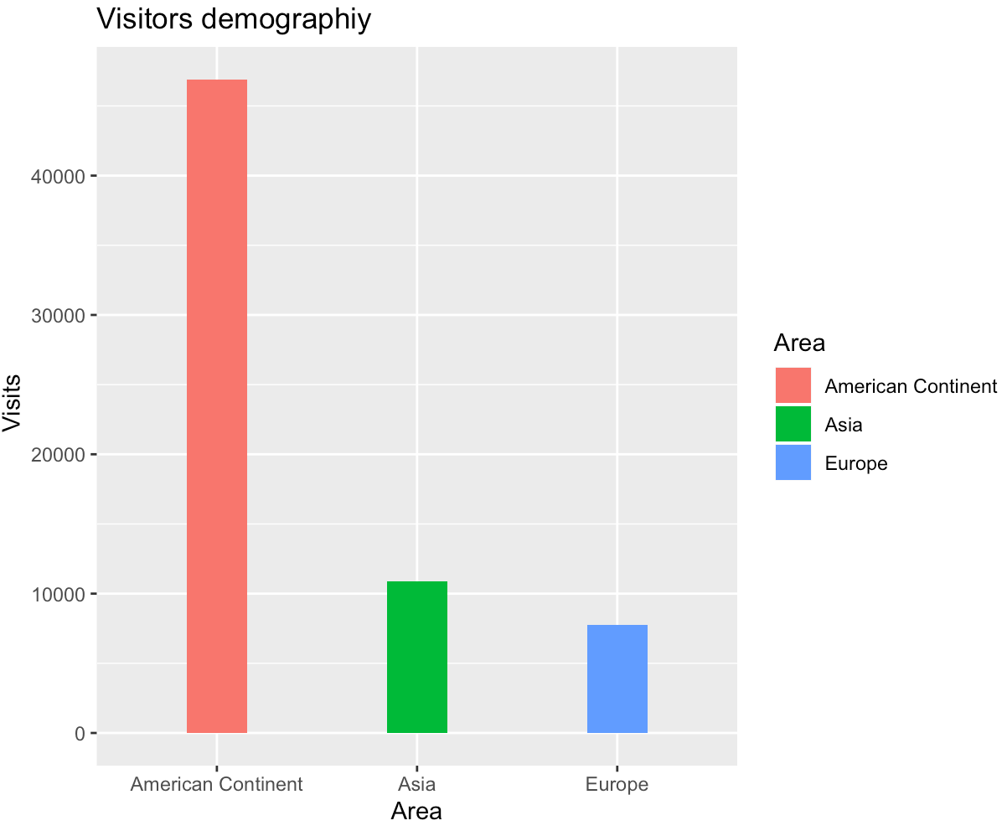
We don’t want to lose Asia & Europe

Slide 26

Benefits
Optimize the inquires form
Date collection +
Categorize product portfolio
Useful for global markets
Understand customers’ needs
Notes:
The benefits of the inquiry optimization are increasing data collection. The company is capable of making product portfolio in different customer segmentation, which is helpful to predict orders. Also it helps expand the global markets and understand customers’ needs

Slide 27
AGENDA
Business Problem
Data exploration
Business Insights
The Buyer’s Journey
Recommendation
Prediction model
Notes:
So in the end, we create a model to predict sales revenue.

Slide 28
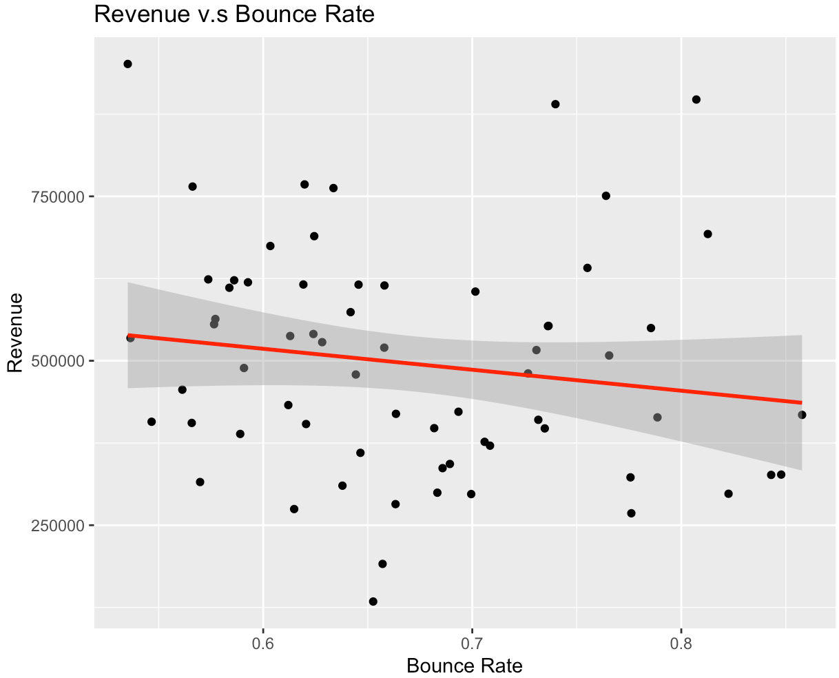
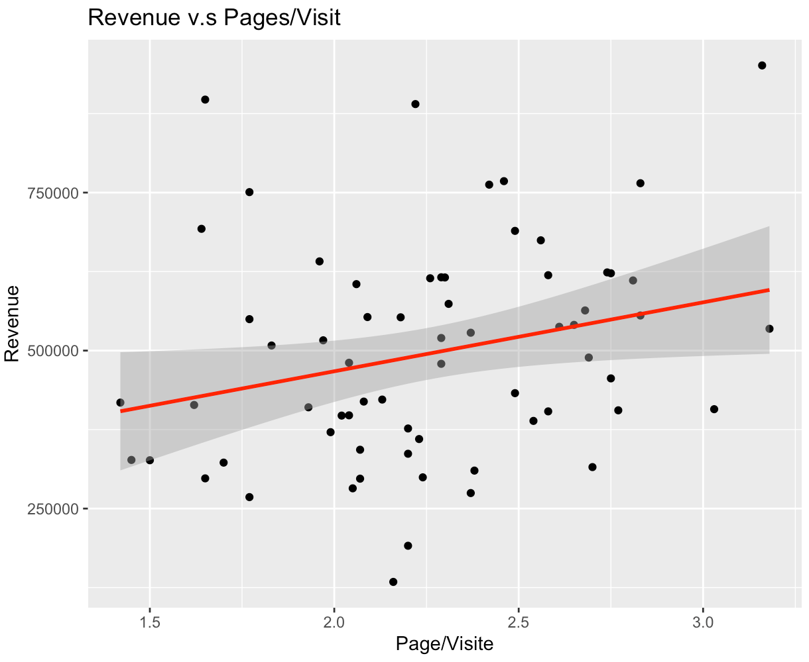
Build A model
Variables for the model
Revenue (Y)
Page/Visits (X1)
Bounce rate (X2)
Revenue=-2,585,439 –Page/Visits * 606,510 + Bounce rate *2,548,141
Notes:
After we exploring data, making calculation and applying regression analysis, we created the model for revenue prediction. To be honest, this model is not reliable but it is the most dependable model compare to the countless models we’ve made. We use page/visits, bounce rate and revenue to build the model and finally we have a better R2 and statistic significant results.

Slide 29
Thank you!

Slide 30
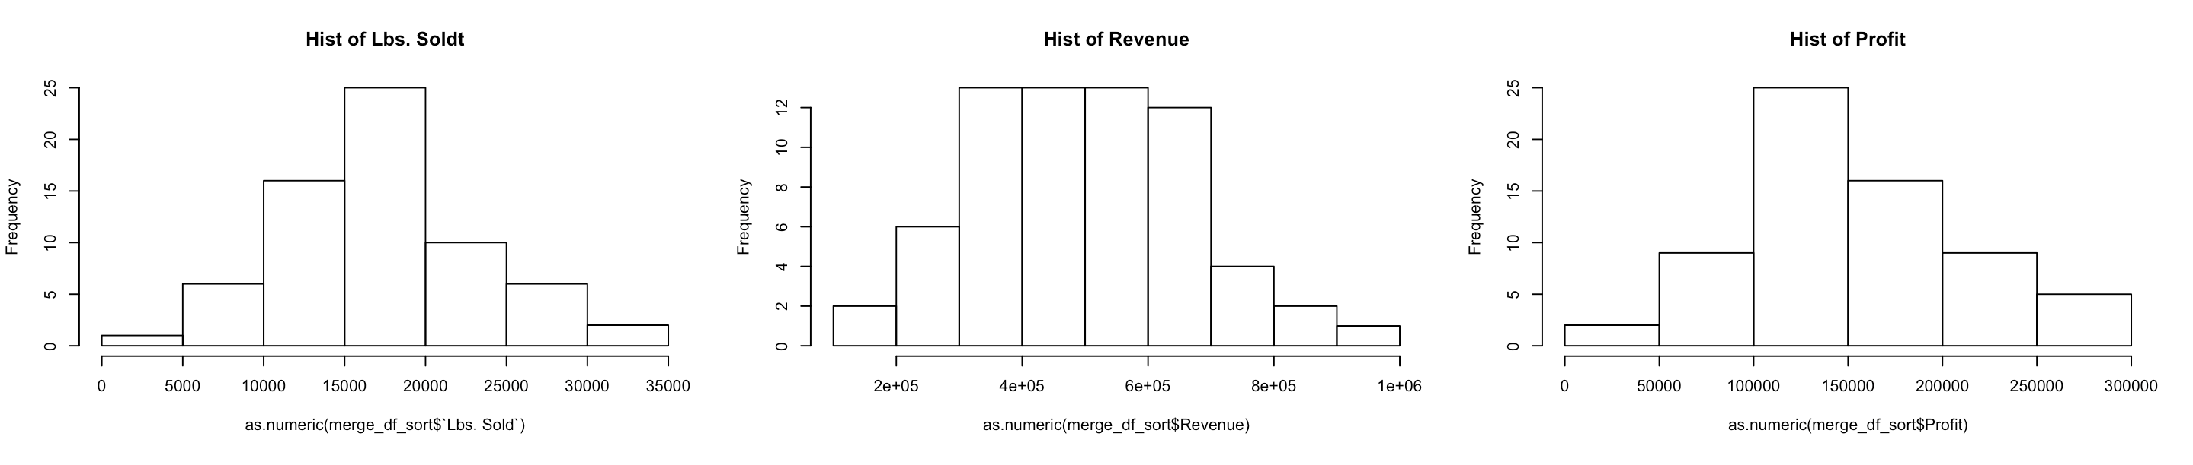
Appendix-Distribution

Slide 31
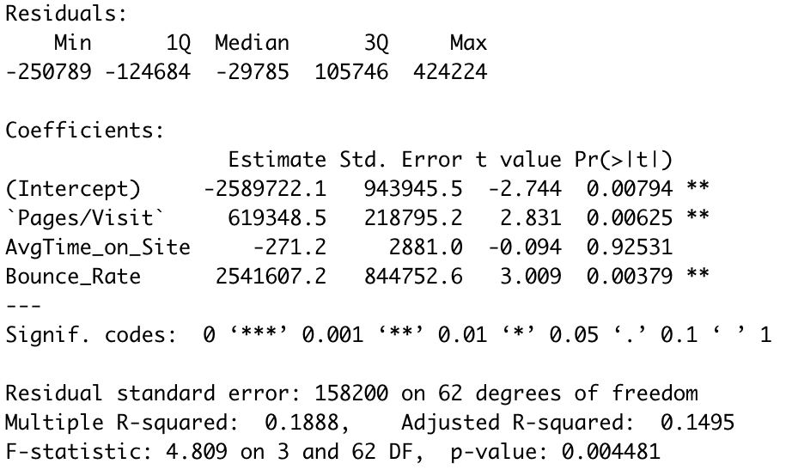
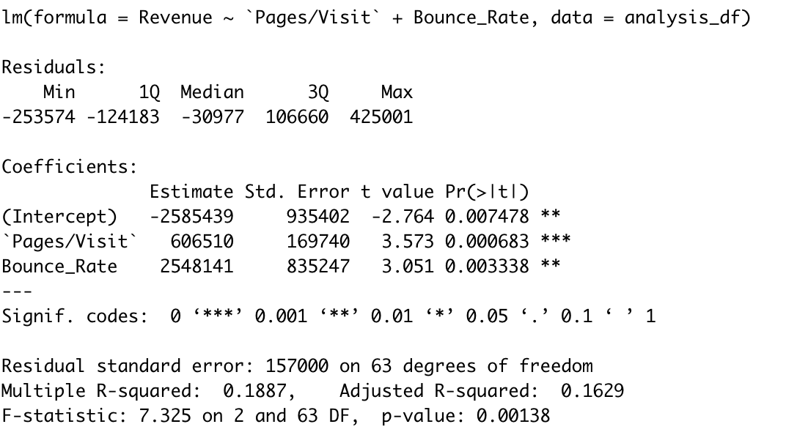
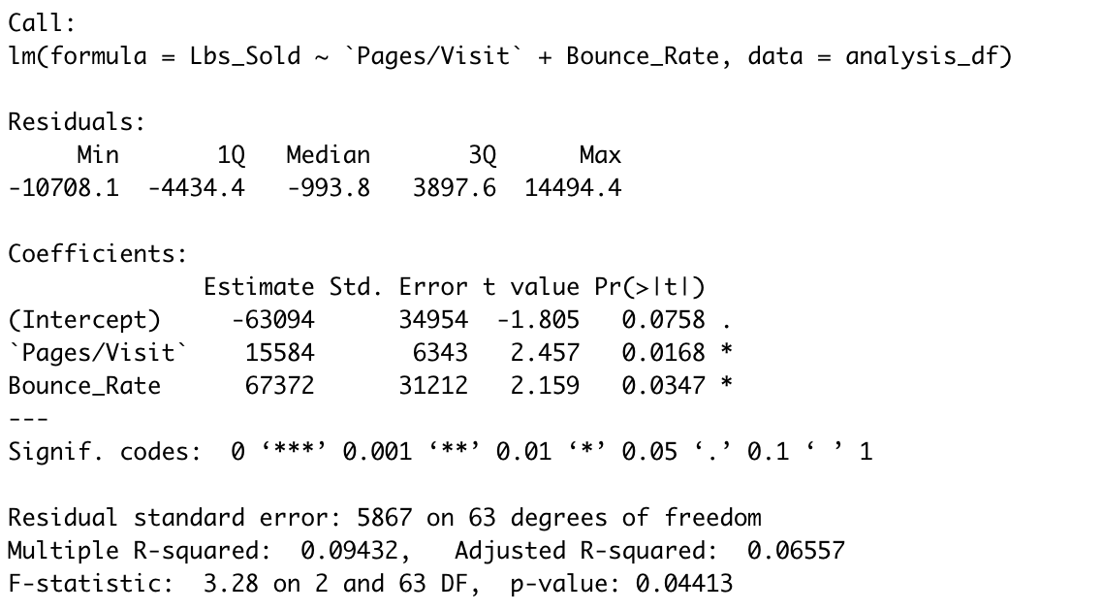
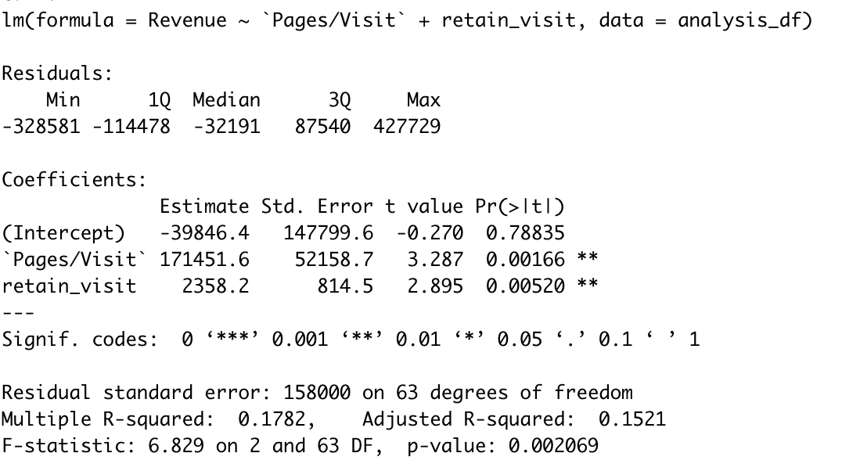
Appendix-Model Index
MODEL 1
MODEL 2
MODEL 4
MODEL 3

Slide 32
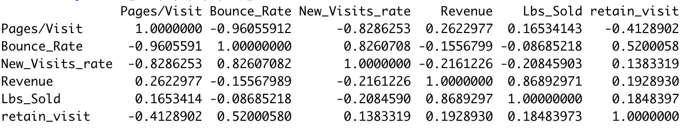
Create a New Column-Retain visits
Create a New Column-Retain visits
RETAIN Visits = Visits – New Visits

Slide 33
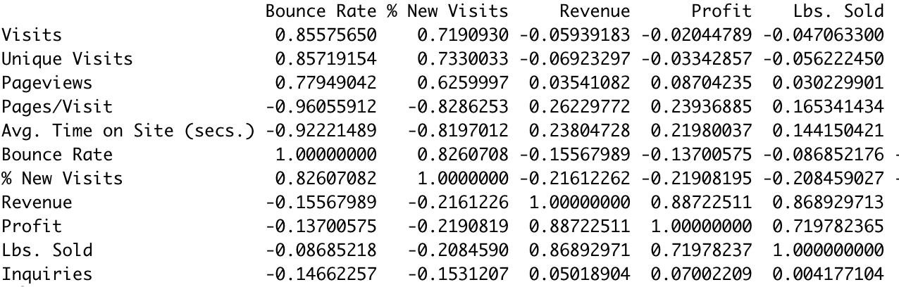
Challenge of Building a Model
None of the variables from Web-Analysis
have high correlation with revenue & pounds-sold

